Slide 1
Scouting and Talent Evaluation
Saryu Onishi
HES 3000-002, Sport Performance Analytics

Slide 2
Draft season
Bunch of athletes, bunch of data. Now what?
  Who has what qualities
  How do they compare
  What qualities are important to us

Slide 3
scouting decision
Boils down to a question of “is this athlete good?”
To answer this, we need
  Comparison / reference
  Comparison method

Slide 4
Performance Profile

Slide 5
First step is to build a performance profile
identify, select, and implement the qualities they believe are most important for them to achieve peak performance in their own sport. I

Slide 6
Compared with whom?
Compare to:
  Position group
  Competition level
  Age
Reference group can change the interpretation
Notes:
Should we compare this athlete with everyone, their position, or athletes at the level we are recruiting for?
Could an athlete be exceptional within their current competition but ordinary within the target competition?
What do we gain—and lose—by comparing only within position?

Slide 7
Simple comparisons
Rank
  Max = top
  Min = last
  Median = middle
Difference
  Distance from the mean, in units of test
  Athlete’s score – mean score
Notes:
Work through

Slide 8
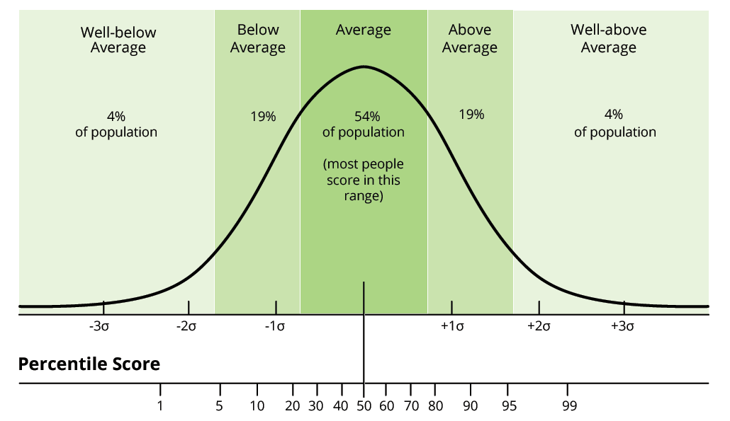
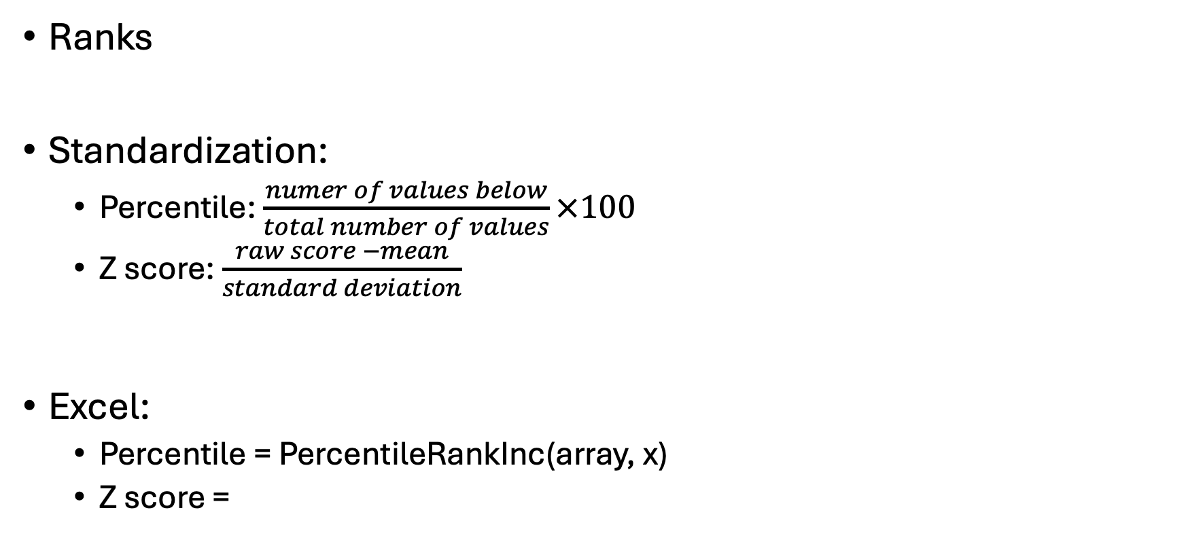
Quantifying relative standing
Ranks
Standardization:
  Percentile: $\frac{numer of values below}{total number of values}×100$
  Z score: $\frac{raw score −mean}{standard deviation}$
Excel:
  Percentile = PercentileRankInc(array, x)
  Z score =
Notes:
Work through

Slide 9
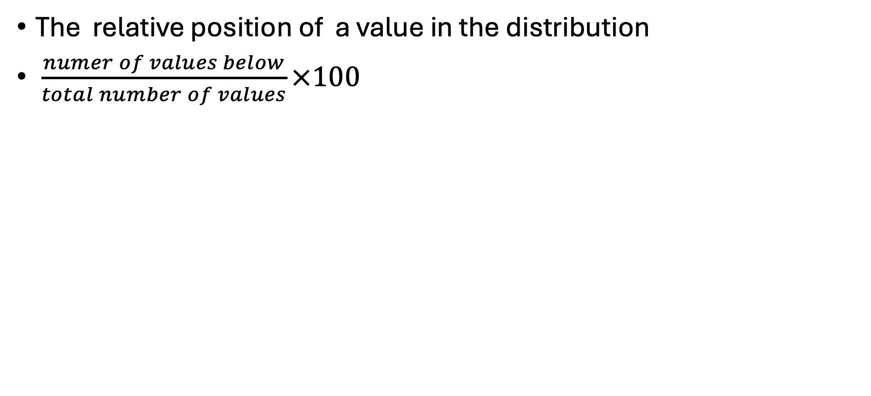
Percentile
The relative position of a value in the distribution
$\frac{numer of values below}{total number of values}×100$

Slide 10
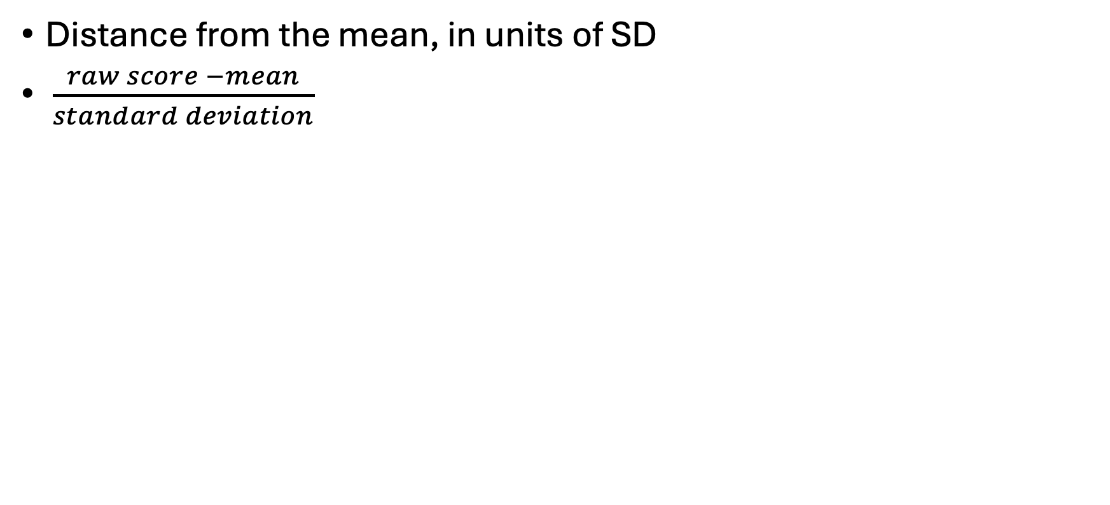
Z score
Distance from the mean, in units of SD
$\frac{raw score −mean}{standard deviation}$

Slide 11
Method | What it tells us | Main limitation
Raw difference from the mean | How far above or below the group mean the athlete falls, in the original units | Does not account for the group’s variability; difficult to compare across measures with different units
Rank | The athlete’s order within the group | Does not show how far apart athletes are
Percentile | The athlete’s relative position in the distribution | Equal percentile differences do not imply equal performance differences
Z-score | How far the athlete is from the group mean, in standard deviations | Less intuitive to interpret; sensitive to outliers

Slide 12
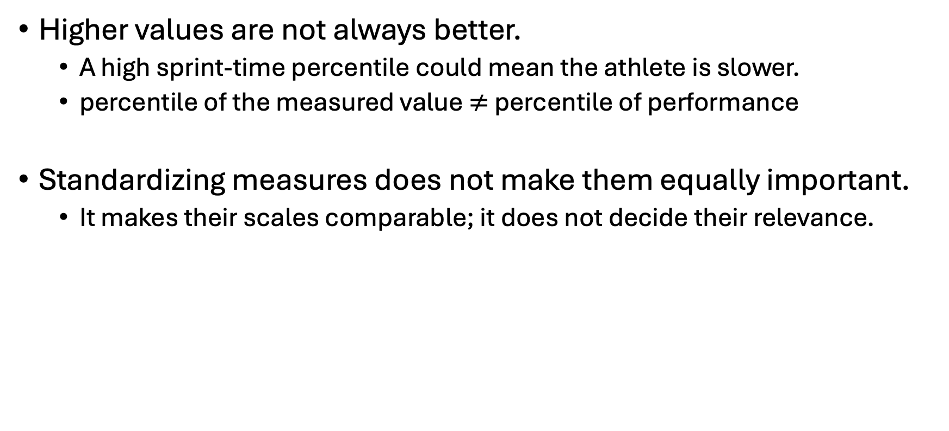
Quantifying relative standing
Higher values are not always better.
  A high sprint-time percentile could mean the athlete is slower.
  percentile of the measured value $≠$ percentile of performance
Standardizing measures does not make them equally important.
  It makes their scales comparable; it does not decide their relevance.

Slide 13
Athlete profiling activity
Identify their athlete’s standing on each measure.
Identify the athlete’s strongest and weakest areas relative to the comparison group.
Make one simple visual showing the profile, such as a horizontal percentile dot plot.
Explain why “above average overall” is difficult to claim from the profile alone.

Slide 14
Compare interpretations

Slide 15
What are we recruiting this athlete to do?
Divide into groups:
  Team A needs a perimeter shooter.
  Team B needs a primary ball handler.
  Team C needs an athletic developmental prospect.
Which athlete did you select?

Slide 16
weighted score
simple weighted score:
$$Score= w_{1}P_{1}+w_{2}P_{2}+w_{3}P_{3}$$
$P$ represents a performance percentile, with higher always representing better performance
weights sum to 1

Slide 17
Choosing the weights
The most valuable discussion is how to choose the weights:
  Role and team needs: What qualities does the athlete need to contribute?
  Sport knowledge: What do coaches and scouts consider relevant, and why?
  Evidence: Do these measures help predict the outcome we care about?
  Measurement quality: Is the apparent strength based on reliable testing and enough observations?

Slide 18
Revisiting activity
Their recruitment goal.
Their selected metrics and weights.
Their preferred athlete.
Whether that choice changes under equal weights or a plausible alternative.
One additional piece of information they would request before recruiting.

Slide 19
Minimum standard?
minimum requirements. A weighted average allows strengths to compensate for weaknesses, but that may be inappropriate for some roles. A team might require a minimum shooting standard before comparing the remaining candidates

Slide 20
Summary
Next time

